Slide 1
Project In Parallel/Distributed Programming
Project Name : Online Poker Application
Lecturer in Charge : Prof. Roy Friedman
Moderator : Mr. Ohad Eytan

Slide 2
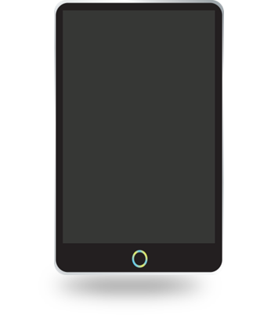
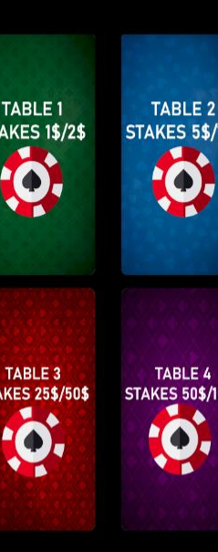
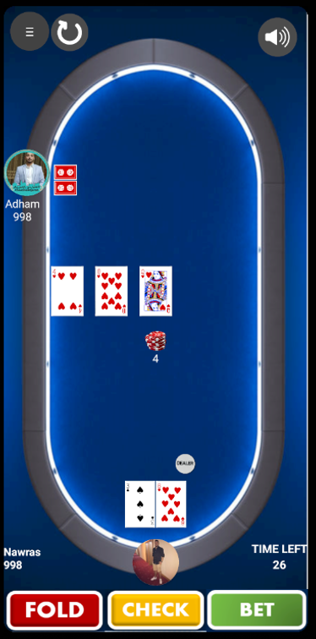
Online Poker Application
General Description
Our application is an interactive online poker app that allows you to play poker games with hundreds of real players from all over the world.
You can enjoy betting and playing poker using the app’s easy and comfortable user interface.
The app provides many poker tables with various betting options allowing each player to play with the budget he prefers.

Slide 3
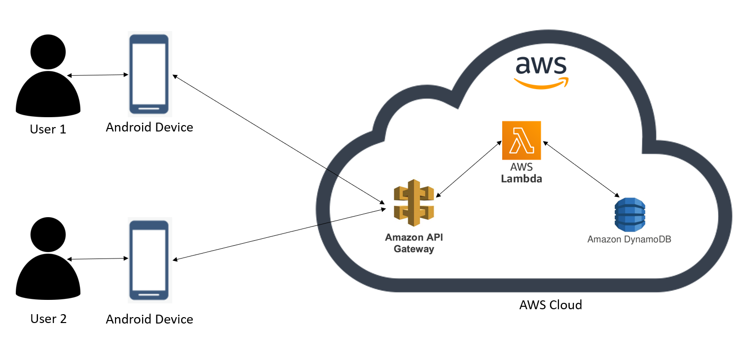
Implementation Architecture
App
Code
App
Code

Slide 4
Technologies Used
01
Python
We used Python as our server-side programming language. The game logic, rules, database management and all controlling functions were written in Python using AWS services.
02
Java
We used Java to write our application’s code. Everything that manages and controls the Android device and the app’s elements’ roles was written in Java using Android Studio.
03
XML (markup language)
We used XML to design the application’s UI layouts and the screen elements they contain such as buttons and images.

Slide 5
Main Modules
01
onConnect
This module’s responsibility is to make all procedures needed after a user logs into the application.
02
onJoin
This module is responsible for all procedures needed when a user joins a table.
03
onSit
This module takes care of everything needed when a user wants to sit on a table and play.
04
Controller
This module’s role is to manage the flow of the game and take care of everything needed for the game to work as expected and according to the rules.
05
clientResponse
This module is responsible for handling responses from client.
06
Utils
This module includes all kinds of helping functions such as : shuffler, winner chooser, pots updater and more.

Slide 6
Main Activities (in Android Studio)
Entry Page (Main Activity)
01
This activity is the first activity the user sees when opening the application. Through this activity the user can log in to his/her account in order to start playing. After logging in the user is moved to the next activity in which he/she can choose a table he/she would like to join.
“Choose A Table” Page
02
This is the activity where the user chooses the table he would like to join. It includes a view of 4 tables as options and a navigation menu which the user can use in order to go back to the entry page, logout and check his account details.
“Poker Table” page
03
This is the activity where the user sees the actual poker table where the game is played. The user can watch the game or sit on a chair and play if he/she likes.

Slide 7
Main Challenges
Lack of Knowledge
01
Since this was our first experience in building online applications, none of us had any knowledge about building applications or working with servers, so we spent a lot of time trying to find what are the best tools, cloud platform and IDE to use for our purpose, trying to figure out how to set things up and learning all the needed knowledge from scratch. This was definitely a big challenge but facing it was exciting and gaining all that knowledge will most certainly help us in the future.
Parallel Executions
02
Like every other online multiplayer game, there are always issues that involve parallel executions. We had these issues for example when two players from different mobiles try to sit on the same chair at the same time, that would cause some mess in the database. But using some AWS tools we managed to solve this issue.
Alpha Presentation Deadline
03
The project demanded a lot of work on both sides, Backend and Frontend. Building a working version before the alpha presentation deadline was a bit challenging. But eventually we managed to finish the whole application before the deadline.

Slide 8
Possible Extensions
Different Poker Versions
01
All tables in our application are played by the Texas Hold’em poker version which is the most playable in the world. A possible extension is to add tables that play by different poker versions such as Omaha Hold’em or Seven Card Study, which gives the user more options to choose.
Creating Tables
02
Our application has a fixed number of tables with a various number of betting options. A possible extension is to let users add customized tables with their own settings such as betting stakes, whether the table is public or private and more.
Invitation Links
03
A possible extension that can be a great addition to the application is invitation links, which can be used if a player wants to invite a friend to play with him on the same table.

Slide 9
Conclusions
What will we take from this experience ?
Online App Development is Fascinating
01
Our first experience in online app development was great. We enjoyed building the application and creating it from scratch while paying attention to both big details and small details, from working with the servers and managing the databases to making sure the right buttons are shown. Overall, we loved it and we will probably love to do it again.
Nothing is Impossible
02
We learned from this project that nothing is impossible, because even though none of us had any knowledge in any part of the project, we still managed to learn everything from scratch using the help of the course’s staff and build a great looking, fully functioning application that we are proud of.

Slide 10
Thank you

